Slide 1
Tobacco Use and Cessation in Older Adults with HIV
Carrie Johnston, MD, MS¹, Rochelle O’Brien BS¹, Scott Bowler MS¹, Atami De Main PhD², Eugenia Siegler MD², Marshall Glesby MD, PhD¹
¹Division of Infectious Diseases, Department of Internal Medicine, Weill Cornell Medicine
²Division of Geriatrics and Palliative Care, Department of Internal Medicine, Weill Cornell Medicine

Slide 2
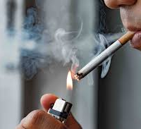
Study Objective
Tobacco use is a leading cause of preventable disease and death, 2-3x use in PWH
We sought to describe the prevalence of current and former tobacco smoking in older PLWH engaged in outpatient care:
Assess cessation attempts amongst active smokers
Measure use of nicotine replacement therapy
Outcome: Smoking status at 1- and 5-year follow-up intervals
Hypotheses:
Ho: Greater # of quit attempts will be associated with successful tobacco cessation at 1 and 5 years.
Ho: Nicotine replacement therapy is likely underutilized (descriptive/subjective) and associated with successful tobacco cessation at 1 and 5 years

Slide 3
Methods
Retrospective cohort study of PLWH aged 50 years and older who were randomly selected from an outpatient HIV clinical practice based at an urban academic medical center.
Participants (N=359) included both English- and Spanish-speakers, who completed a self-administered biopsychosocial questionnaire.

Slide 4
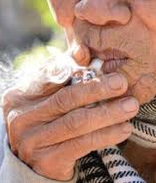
Results
In total, 324 respondents completed survey questions regarding tobacco use.
76 (23%) of respondents reported current tobacco use, 112 (35%) had previously used tobacco then quit, and 135 (42%) had never used tobacco.
Amongst current tobacco users, 86% indicated a desire to quit, and of those with desire to quit, 91% had attempted to quit in the previous 12 month

Slide 5
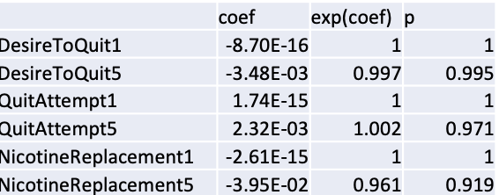
Smoking Cessation Cascade
5 year cessation

Slide 6
Conclusions
Nearly one quarter of PLWH age 50 and older reported current tobacco use in a cohort study, of which the majority indicated a desire to quit.
Ho Result: Cessation Attempts and NRT use NOT associated with cessation
These findings suggest that older PLWH may benefit from novel and enhanced tobacco use screening and resources dedicated to smoking cessation.

Slide 7
Acknowledgements
Weill Cornell CCTU:
Marshall Glesby MD, PhD
Rochelle O’Brien BS Study Participants!
Statistician:
Scott Bowler MS
Weill Cornell Geriatrics and Palliative Care:
Atami De Main PhD Eugenia Siegler MD

